Slide 1
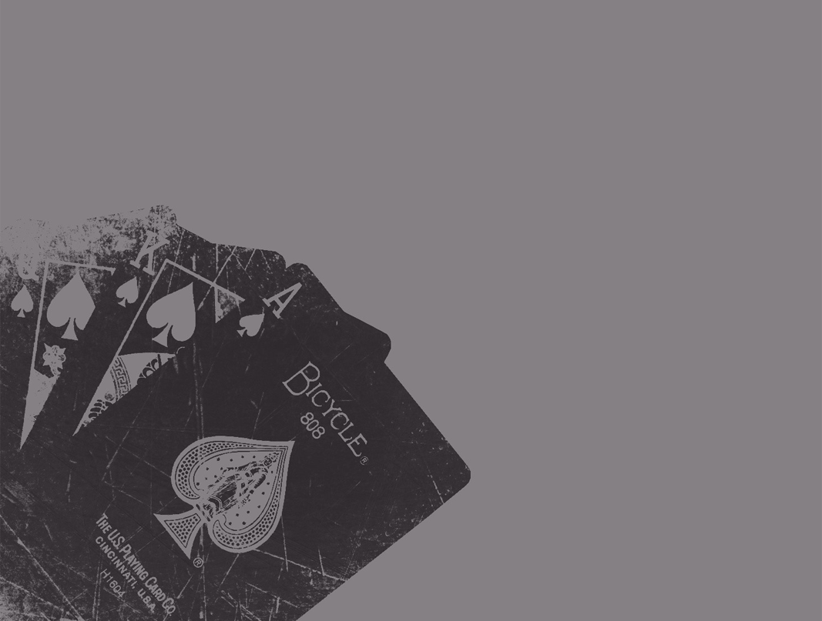
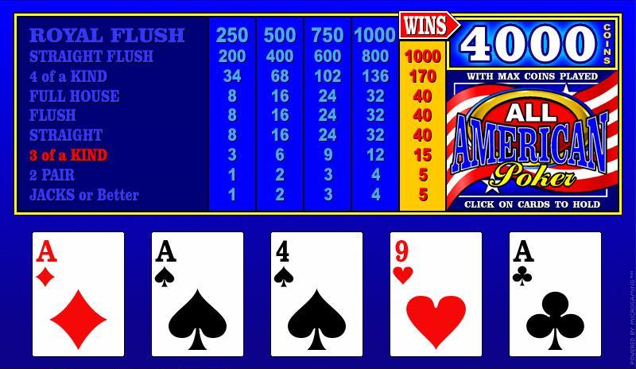

Video Poker Tutor
Darrell Hickman & Nicole De Los Reyes
Enhanced Poker learning through our tutor with GUI interface for better visual comprehension.
“LEARN TO WIN”
0%
0%
4.1%
6.1%
0%
0%
--->
Toggle:
Trainer
Probabilities
Test Hands (ends round)
HELD
HELD
HELD
Click here to be linked to our Github Repository

